Slide 1
Eikon NAM.18S.190 (Mosquito) Assay

Slide 2
Overview
Components
Positive Control
10% TE Buffer
EEEV.1029b.Trunc*
SLEV.10535.Temp*
WNV.3770.Trunc*
NAM.18S.190.2SDNATemplate*
Template Control
10% TE Buffer
NAM.18S.190.ExtTemplate (CF610)
5e8 Copies/rxn
Master Mix
EEEV F/R
SLEV F/R
WNV F/R
NAM F/R
2x Promega MME
RT Dilution 320U/uL
*5e6 Copies/rxn
3 Reactions:
Positive Control
NTC
Extraction Control
Each reaction was made by mixing 5 uL of the provided Master Mix with 5 uL of the corresponding control. Nuclease free water was used as the negative control.

Slide 3
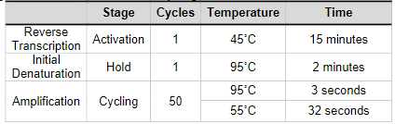
PCR Parameters

Slide 4
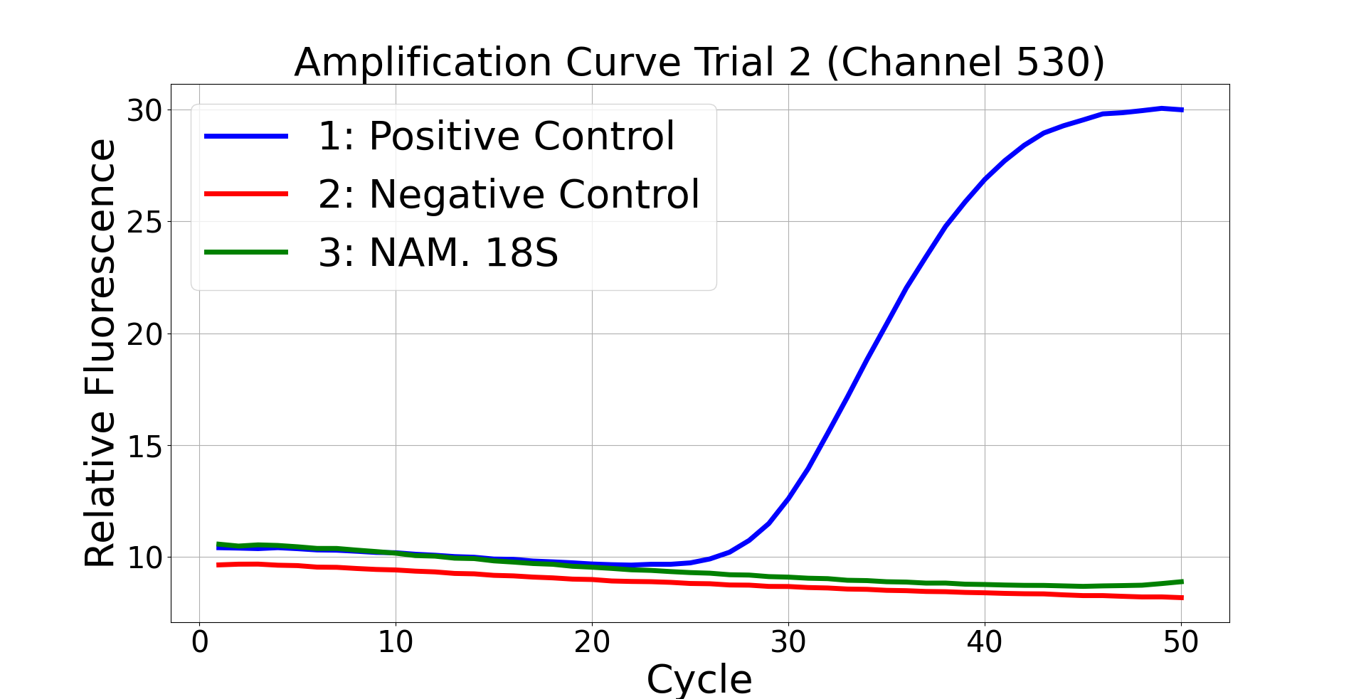
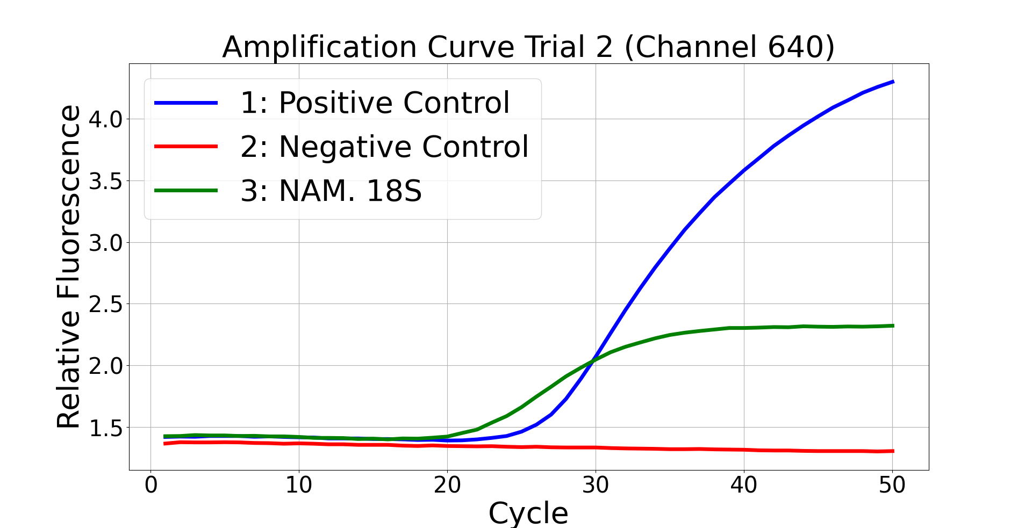
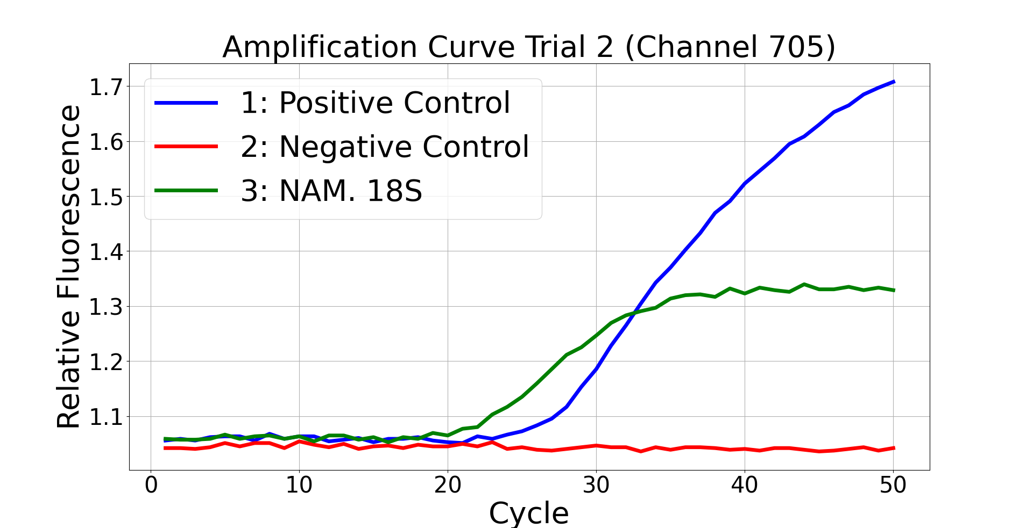
Results (Trial 2)
The template control provided a signal in channel 640 and 705 but not channel 530.

